Slide 1
Programming Fundamental
Week 01
Sobia Iftikhar
Sobia.Iftikhar@nu.edu.pk

Slide 2
Objectives of course
Getting acquainted with problem understanding, modeling and solving. Understanding the concept of Programming Languages. Two major areas to be covered: Computation and problem solving Implementation in C language. Design and implement algorithms to solve real world problems.

Slide 3
Course outline
Week 05
Week 10
Discussion of the course outline, Introduction to problem solving, What is algorithm, How to write pseudo code, programming structures, problem solving with the sequential structures and, Basic Flowchart, IPO and PAC.
problem solving with decisions and iterative structures, Basic Computer Organization, Intro to IDE (compiled program, text editors, debuggers, etc), Program structure and Execution, First Program with Input and Output.
Constant, Variables, Keywords, Escape sequence, Format Specifiers, Data types, Data manipulation, Library, Linking, Compiling & Loading.
Decision Control Structures: If statements and if-else statement, Basic switch statements, Some working examples.
Nested if statements & switch statements 2. Logical & Conditional Operators 3. Working examples.
Introduction to Loops Design, For, while and do-while loops, Some working examples.
Nested Loops, Break and Continue Statement, Working examples.
Introduction to 1D Arrays, Multiple subscripted arrays, Working examples.
Functions: Declaration, Definition and Calling, Passing values to functions, Passing arrays to functions, Standard library string functions, 2D array of characters.
Recursion 2. Introduction to Structures and Structure array 3. Working examples.
Nested structures, Passing structure function 2. Introduction to pointers 3. Pointers and Arrays.
Dynamic memory allocation 2. Void pointers
Week 01
Week 02
Week 07
Week 06 – MID 1
Week 12
Week 11– MID 2
Week 03
Week 08
Week 13
Week 04
Week 09
Week 14
Week 15- Revision
Week 16- FINAL EXAM

Slide 4
Grading Scheme
Mid-1 & 2: 15 each
Assignment: 20
Final: 50

Slide 5
Class 01 06-Sep-2021

Slide 6
Content
Introduction to problem solving
What is algorithm, How to write pseudo code
Programming structures
Problem solving with the sequential structures
Basic Flowchart, IPO and PAC

Slide 7

Problem solving Concepts
People make decisions every day to solve problems that affect their lives. If a bad decision is made, time and resources are wasted, so it’s important that people know how to make decisions well.
For this, There are six steps to follow to ensure the best decision.

Slide 8
These six steps in problem solving include the following:
Identify the problem
Understand the problem.
Identify alternative ways to solve the problem.
Select the best way to solve the problem from the list of alternative solutions.
List instructions that enable you to solve the problem using the selected solution.
Evaluate the solution.
1
2
3
4
5
6

Slide 9
Problem
Consider the following problem.
“what to do this evening.”

Slide 10
Solution
Identify the problem. How do the individuals wish to spend the evening?
Understand the problem. With this simple problem, also, the knowledge base of the participants must be considered. The only solutions that should be selected are ones that everyone involved would know how to do. You probably would not select as a possible solution playing a game of chess if the participants did not know how to play.
Identify alternatives.
a. Watch television.
b. Invite friends over.
c. Play video games.
d. Go to the movies.
e. Play miniature golf.
f. Go to the amusement park.
g. Go to a friend’s party.
The list is complete only when you can think of no more alternatives.

Slide 11
Solution (cont.)
Select the best way to solve the problem.
Weed out alternatives that are not acceptable, such as those that cost too much money or do not interest one of the individuals involved.
Specify the pros and cons of each remaining alternative.
Weigh the pros and cons to make the final decision. This solution will be the best alternative if all the other steps were completed well.
Prepare a list of steps (instructions) that will result in a fun evening.
Evaluate the solution. Are we having fun yet? If nobody is having fun, then the planner needs to review the steps to have a fun evening to see whether anything can be changed, if not then the process must start again.

Slide 12
Types of Problem
Problems with algorithmic solutions
Problems with heuristic solutions

Slide 13
Problems with algorithmic solutions
Can be solved in a number of steps e.g. balancing a check book.
Algorithm: A number of steps that may be performed repeatedly to reach some solution

Slide 14
Problems with heuristic solutions
Solutions that cannot be reached through a direct set of steps are called heuristic solutions.
These solutions require reasoning built on knowledge and experience, and a process of trial and error.
Example: how to buy the best stock or whether to expand the company

Slide 15
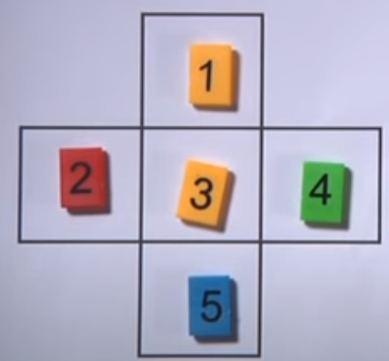
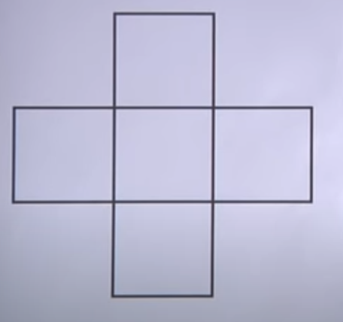

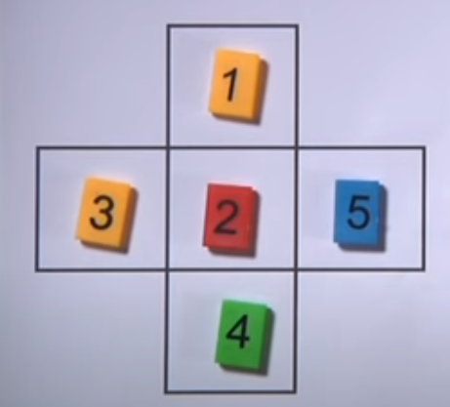
Problems with heuristic solutions
First guess:
v = 1+3+5 = 9
H = 2+3+4 = 9
Arrange a number in way that sum of vertical is equal to sum of horizontal?
First guess:
v = 1+2+4 = 7
H = 3+2+5 = 10

Slide 16
Class 02 07-Sep-2021

Slide 17
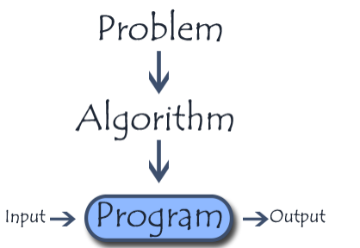
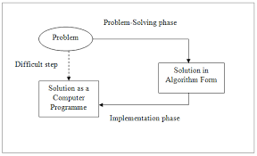
Problem solving with computers
The problem-solving process is not easy. It takes practice and time to perfect, but
in the long run the process proves to be of great benefit.
Program means the set of instructions that make up the solution after they have been coded into a particular computer language.
Output/Results means the outcome or the completed computer-assisted answer.

Slide 18
Instructions
Instruction can be written in two ways:
Pseudo code
Algorithm

Slide 19
Algorithm
The algorithm is procedure or step by step instruction that you tell computer to do.
To make a computer to do some task, one need a computer program.
To write computer program, computer needs step by step statement, what you exactly want to do.
Its better to write algorithm before writing the actual computer program
Properties of algorithm:
Given problem should be broken into meaning full step
Should be numbered sequentially
Should be descriptive in simple English.

Slide 20
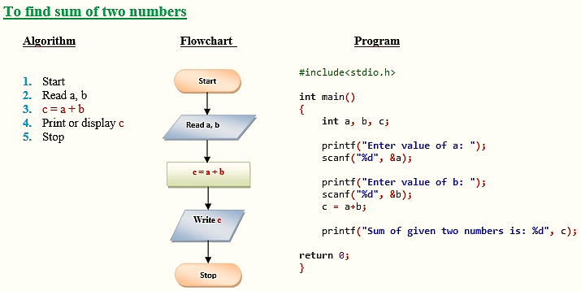
Example

Slide 21
Pseudo code
Pseudo code describes how you would implement an algorithm without getting into syntactical details
Pseudo code is an informal way of writing a program. It is not exactly a computer program. It represents the algorithm of the program in natural language and mathematical notations.

Slide 22
Example
Pseudo code to add 2 numbers is as follows:
SumOfTwoNumbers()
Begin
Set sum=0;
Read: num1, num2;
Set sum = num1+num2;
Print sum;
End

Slide 23
Difficulties in Problem solving
The problem-solving process is not easy. takes practice and time to perfect
When solving problems on the computer, one of the most difficult tasks for the problem solver is writing the instructions.
Take the task of deciding which number is the largest from a group of three numbers. Almost anyone can immediately tell which
is the largest, but many cannot explain the steps they followed to arrive at it.
Poor training
Afraid to make decisions
Incorrect problem definition
Insufficient steps of algorithm

Slide 24
What Problem Can Be Solved By Computer
When the solution can be produced by a set of step-by-step procedures or actions.
This step-by-step action is called an algorithm.
The algorithm will process some inputs and produced output.
Solving problem by computer undergo two phases:
Phase 1:
Organizing the problem or pre-programming phase.
Phase 2:
Programming phase.

Slide 25
Pre-programming Phase
Analyzing the problem.
Developing the Hierarchy Input Process Output (HIPO) chart or Interactivity Chart (IC).
Developing the Input-Process-Output (IPO) Chart.
Drawing the Program flowcharts.
Writing the algorithms.

Slide 26
Pre-programming Phase
Analyzing The Problem
Understand and analyze the problem to determine whether it can be solved by a computer.
Analyze the requirements of the problem.
Identify the following:
Data requirement.
Processing requirement or procedures that will be needed to solve the problem.
The output.

Slide 27
Pre-programming Phase
All These requirements can be presented in a Problem Analysis Chart (PAC)
Data | Processing | Output
given in the problem or provided by the user | List of processing required or procedures. | Output requirement.

Slide 28
Pre-programming Phase
Example: Payroll Problem
Calculate the salary of an employee who works by hourly basis. The formula to be used is
Salary = Hour works * Pay rate
Data | Processing | Output
Hours work, Pay rate | Salary = Hours work * payrate | Salary

Slide 29
Problem 1
Write a Problem Analysis Chart (PAC) to convert the distance in miles to kilometers where 1.609 kilometers per mile.
Data | Processing | Output
Distance in miles | Kilometers = 1.609 x miles | Distance in kilometers

Slide 30
Problem 2
Write a Problem Analysis Chart (PAC) to find an area of a circle
where area = pi * radius * radius
Data | Processing | Output
radius | area = 3.14 x radius x radius | area

Slide 31
Problem 3
Write a Problem Analysis Chart (PAC) to compute and display the temperature inside the earth in Celsius and Fahrenheit. The relevant formulae are
Celsius = 10 x (depth) + 20
Fahrenheit = 1.8 x (Celsius) + 32
Data | Processing | Output
depth | celsius = 10 x (depth) + 20 fahrenheit = 1.8 x (celsius) + 32 | Display celsius, Display fahrenheit

Slide 32
PRE-PROGRAMMING PHASE
Developing the Hierarchy Input Process Output (HIPO) or Interactivity Chart
The problem is normally big and complex.
Thus, requires big program.
Thus, the processing can be divided into subtasks called modules.
Each module accomplishes one function.
These modules are connected to each other to show the interaction of processing between the modules.

Slide 33
Pre-programming Phase
Main/control module controls the flow all other modules.
The IC is developed using top-down-method: top to down left to right order (also refer to order of processing).
Modules are numbered, marked for duplication, repetition or decision.

Slide 34
Pre-programming Phase
The interaction will form a hierarchy, called Hierarchy Input Process Output Chart (HIPO) or Interactivity Chart (IC). Programming which use this approach (problem is divided into subtasks) is called Structured Programming.
Main Module
Module 1
Module 2
Module 3
Module 4
Module 5
Module 6

Slide 35
Pre-programming Phase
Developing the Input Process Output (IPO) Chart
Extends and organizes the information in the Problem Analysis Chart.
It shows in more detail what data items are input, what are the processing or modules on that data, and what will be the result or output.
It combines information from PAC and HIPO Chart.

Slide 36
Pre-programming Phase
Input | Processing | Module | Output
-Hours Worked -Pay Rate -Deduction | -Enter Hourly Worked -Enter Pay Rate -Calculate Gross Pay -Enter Deductions -Calculate Net Pay -Print Cheque -End | 1100 1200 1000 2100 2000 3000 0000 | -Net pay

Slide 37
Problem 1
Write a Input Process Output (IPO) to convert the distance in miles to kilometers where 1.609 kilometers per mile.
Input | Processing | Module | Output
-Distance in Miles | -Enter distance -Kilometers = 1.609 x distance -Display kilometers | 1000 2000 3000 | -Distance in kilometers

Slide 38
Problem 2
Write a Input Process Output (IPO) to find an area of a circle
where area = pi * radius * radius
Input | Processing | Module | Output
- radius | - Enter radius - area = 3.14 x radius x radius Display area end | 1000 2000 3000 0000 | - Area of a circle

Slide 39
Problem 3
Write an Input Process Output (IPO) that asks a user to enter the distance of a trip in miles, the miles per gallon estimate for the user’s car, and the average cost of a gallon of gas. Calculate and display the number of gallons of gas needed and the estimated cost of the trip.

Slide 40
Solution
Input | Processing | Module | Output
Distance in miles Miles per gallon Cost gas per gallon | Enter distance Enter miles per gallon Calculate total gas needed Enter cost gas per gallon Calculate estimated cost Display total gas and estimated cost End | 1100 1200 1000 2100 2000 3000 0000 | Total gas needed Estimated cost

Slide 41
Class 03 07-Sep-2021

Slide 42
Pre-programming Phase
Drawing the Program Flowcharts
Flowchart is the graphic representations of the individual steps or actions to implement a particular module.
The flowchart can be likened to the blueprint of a building. An architect draws a blueprint before beginning construction on a building, so the programmer draws a flowchart before writing a program.
Flowchart is independent of any programming language.

Slide 43
Pre-programming Phase
Flowchart is the logical design of a program.
It is the basis from which the actual program code is developed.
Flowchart serves as documentation for computer program.
The flowchart must be drawn according to definite rules and utilizes standard symbols adopted internationally.
The International Organization for Standardization (IOS) was the symbols shown below (You can draw the symbols using ready-made flowcharting template):

Slide 44
Pre-programming Phase
Symbol | Function
 | Show the direction of data flow or logical solution.
 | Indicate the beginning and ending of a set of actions or instructions (logical flow) of a module or program.
 | Indicate a process, such as calculations, opening and closing files.

Slide 45
PRE-PROGRAMMING PHASE
 | Indicate input to the program and output from the program.
 | Use for making decision. Either True or False based on certain condition.
 | Use for doing a repetition or looping of certain steps.
 | Connection of flowchart on the same page.
 | Connection of flowchart from page to page.

Slide 46
PRE-PROGRAMMING PHASE
Example 2.3 : Sale Problem
Draw a flowchart for a problem that to read two numbers. The first number represents the unit price of a product and the second number represents the quantity of the product sold. Calculate and print the total sale.
Solution: Stepwise Analysis of the Sale Problem
Start of processing
Read the unit price
Read the quantity
Calculate total sale
Print total sale
Stop the processing

Slide 47
PRE-PROGRAMMING PHASE
START
A
READ
UNIT PRICE
TOTAL SALE =
UNITPRICE × QUANTITY
READ
QUANTITY
PRINT
TOTALSALE
A
STOP

Slide 48
PRE-PROGRAMMING PHASE
Finding Average Problem
Read a sequence of number, find the average of the number and print the average.
Solution: Stepwise Analysis of Average Problem
Start the processing
Read a number
Add the number
Repeat reading until last data
Calculate the average
Print the average
Stop the processing

Slide 49
Pre-programming Phase
Start
Read
Number
Accumulate
Total
Repetition Until End Of Data
Calculate
Average
Print
Average
Stop

Slide 50
Pre-programming Phase
Start
X
Counter
= ∅
Average = Total
Counter
Read Number
Print Average
Total = Total + Number
Counter = Counter + 1
Stop
End Of Data
X

Slide 51
PRE-PROGRAMMING PHASE
TASK:
Draw a flow chart to print the sum of all even numbers between 1 to n.

Slide 52
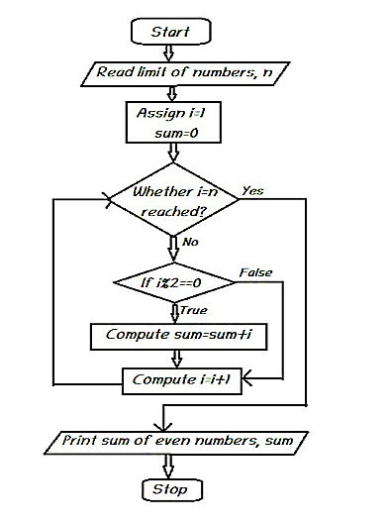
Solution
Step 1: Start
Step 2: Read the limit of numbers, n
Step 3: Assign i=1
Step 4: Assign sum=0
Step 5: Repeat steps 6,7&8 until i=n reaches
Step 6: If i%2==0 goto step 7
Step 7: Compute sum=sum+i
Step 8: Compute i=i+1
Step 9: Print sum of even numbers, sum
Step 10: Stop

Slide 53
PRE-PROGRAMMING PHASE
5. Writing the Algorithm (Pseudocode)
Pseudocode means an imitation computer code.
It is used in place of symbols or a flowchart to describe the logic of a program. Thus, it is a set of instructions (descriptive form) to describe the logic of a program.
Pseudocode is close to the actual programming language.
Using the Pseudocode, the programmer can start to write the actual code.

Slide 54
START
READ
PRICE
READ
QUANTITY
Algorithm:
Start Read price, quantity
Sale = price x quantity
Print Sale End
SALE = PRICE ×
QUANTITY
PRINT
SALE
STOP

Slide 55
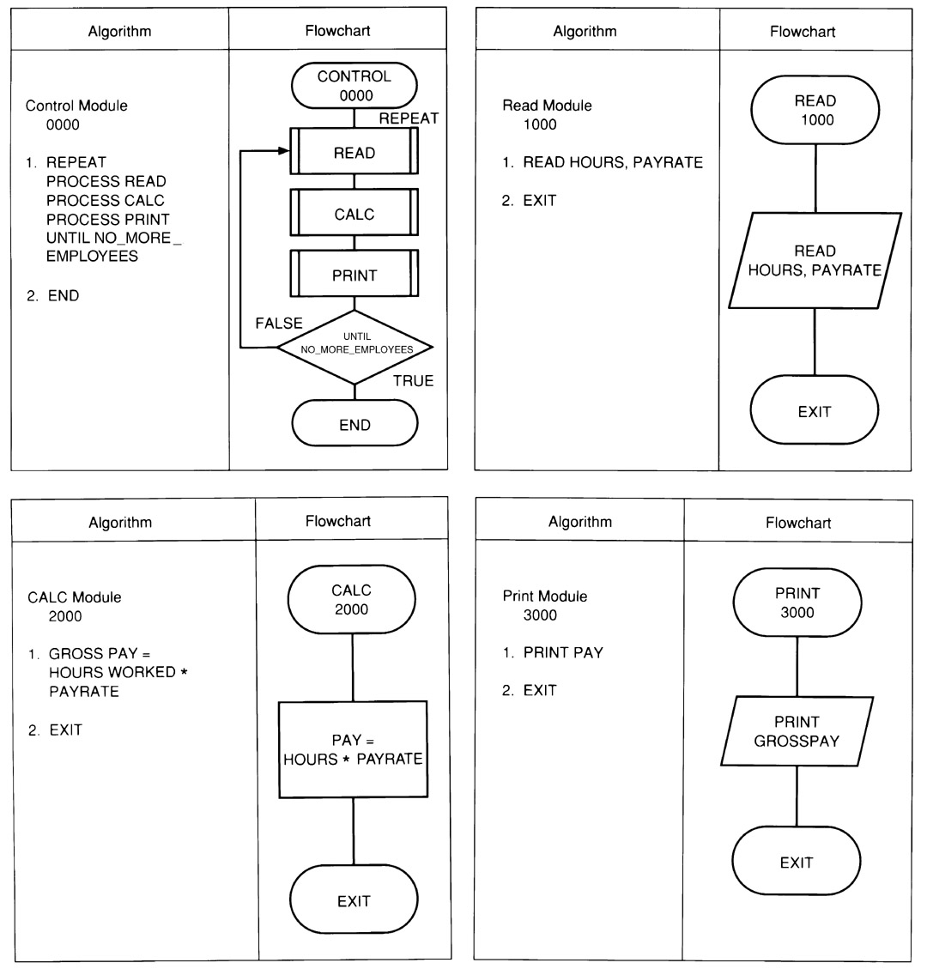
Example: Flowchart & Algorithm

Slide 56
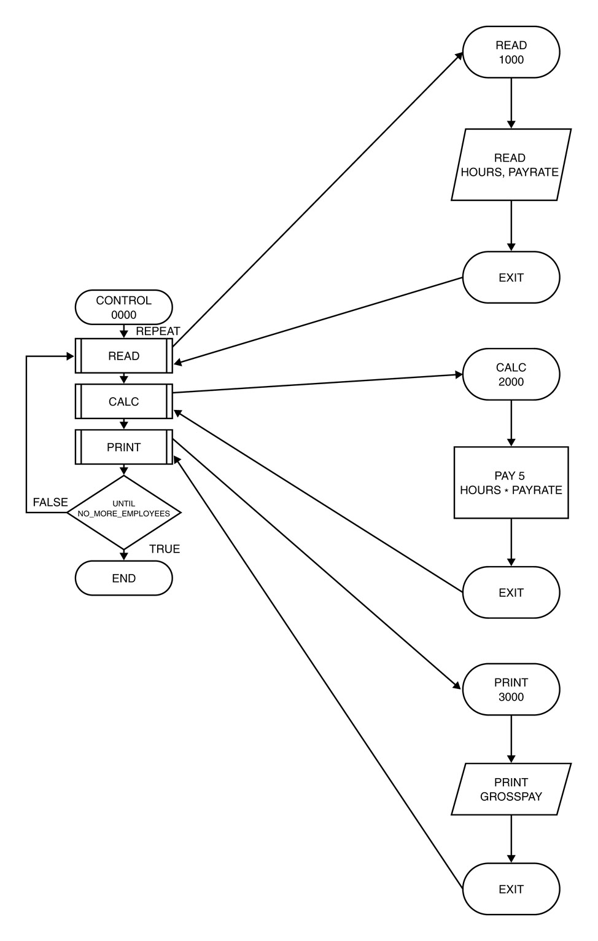
Order of Execution of Instructions : Payroll System

Slide 57
Structuring a Program
Develop efficient computer solution to problems:
Use Modules
Use four logic structures
Sequential structure
Executes instructions one after another in a sequence.
Decision structure
Branches to execute one of two possible sets of instructions.
Loop structure
Executes set of instruction many times.
Case structure
Executes one set of instructions out of several sets.
Eliminate rewriting of identical process by using modules.
Use techniques to improve readability including four logic structure, proper naming of variables, internal documentation and proper indentation.

Slide 58
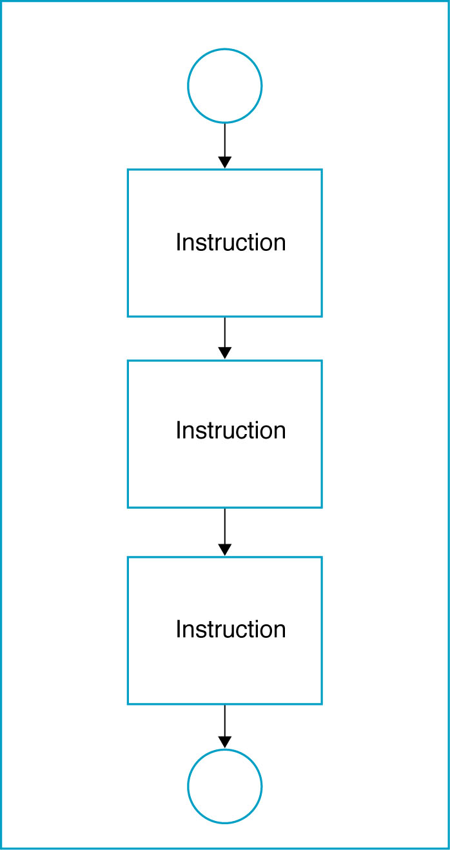
a. Sequential Logic Structure

Slide 59
THANK YOU

